Slide 1
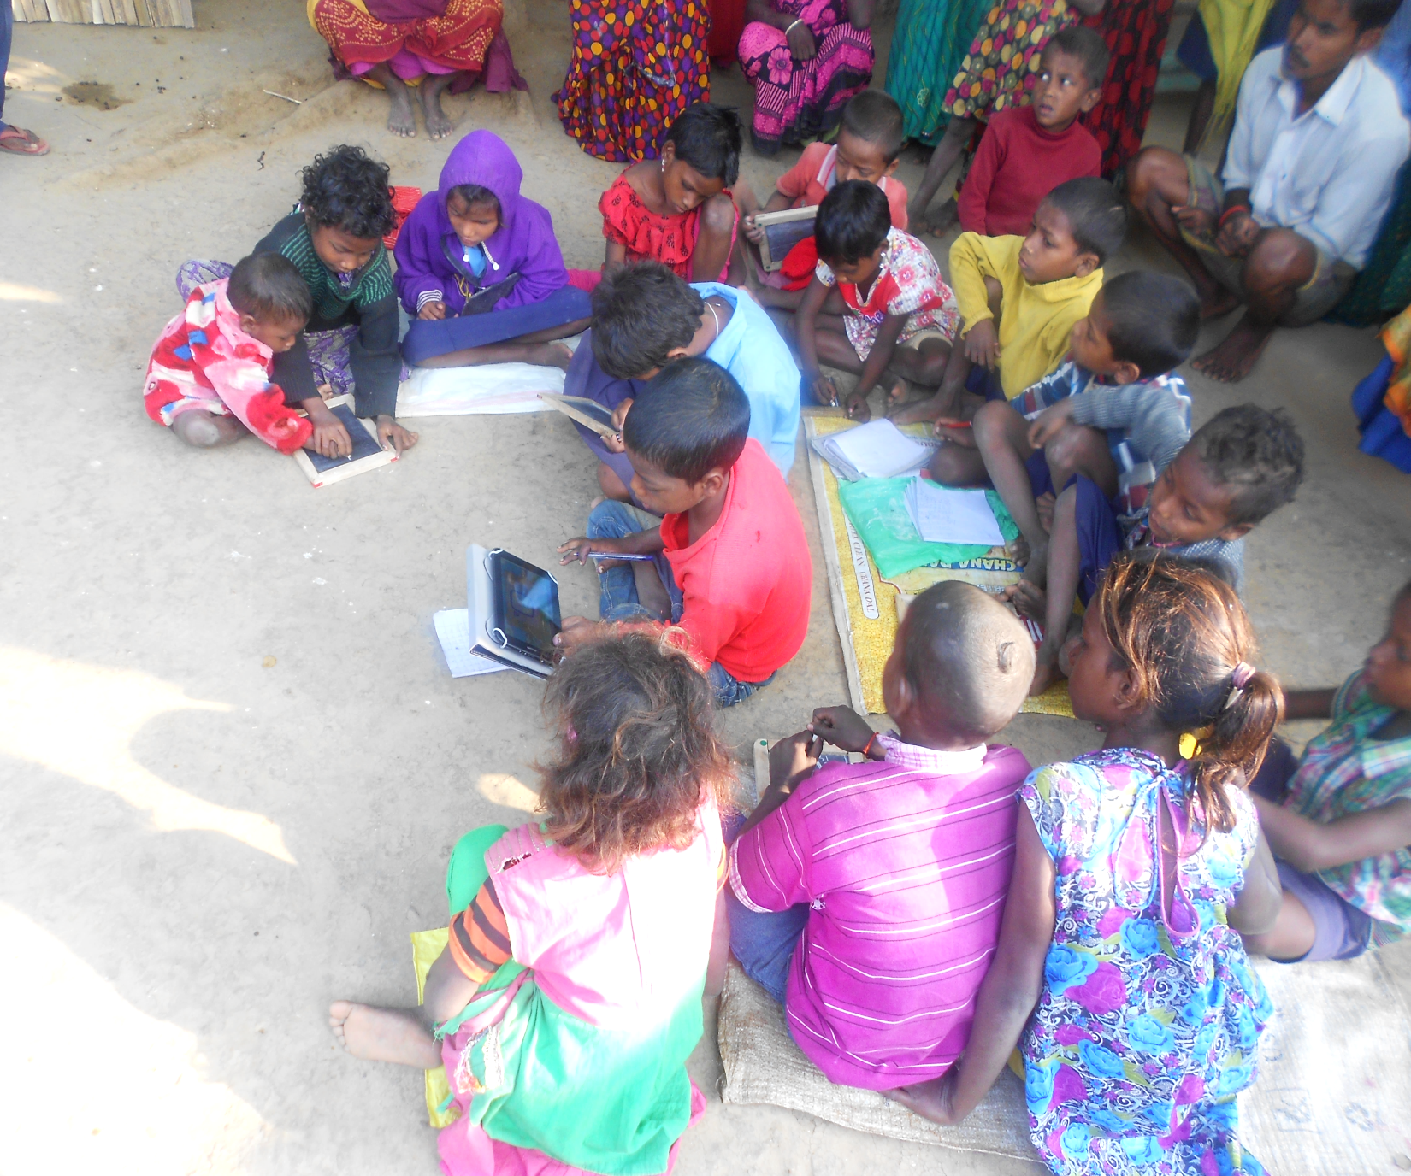
ANNUAL REPORT
2015-16
I-SAKSHAM EDUCATION AND LEARNING FOUNDATION

Slide 2
ASER 2013 Report
I-Saksham is an initiative by 3 Prime Minister Rural Development Fellows, who during the course of their fellowship encountered with the pathetic status of education in remote areas of Munger and Jamui districts of Bihar.
Only 47% of class 5 children can read class 2nd text
Only 20.8% of class 5 children could solve a three-digit by one-digit division problem

Slide 3




The Challenges
1
Poor learning attainment among students
2
Absence of
quality teachers, skill training providers in localities near to difficult areas
3
Issues of accessibility and affordability
4
Dependence
on centralized delivery model

Slide 4
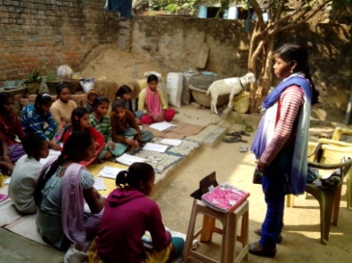
The Challenges made us Question :
Can there be an intervention that complement and supplement teachers, enhance their capability, be an effective substitute when required, engages students and make learning an interesting experience?
and
i-Saksham was born

Slide 5
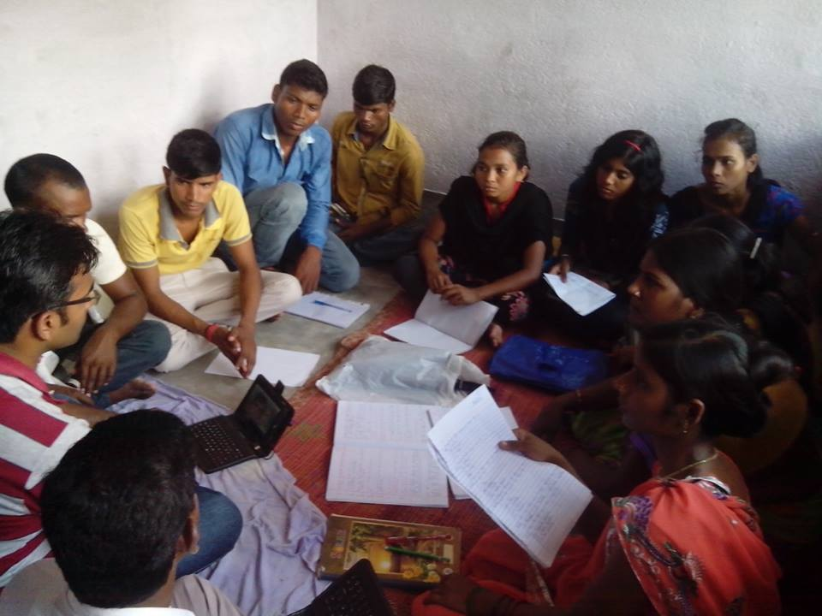
Local community tutors (Saksham Mitra) were selected, trained and provided with capabilities and resources to empower their community through education and awareness, while earning a livelihood for themselves.

Slide 6
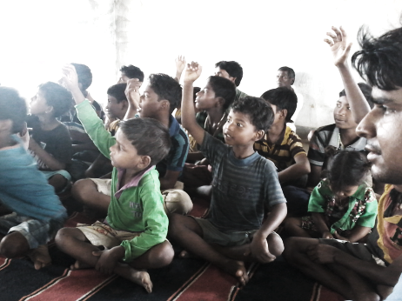
Mission and Vision
VISION
A society where people from excluded sections are well educated, skilled and self reliant.
MISSION
To provide in-situ education and skill development services in unreached areas to enterprising young community educators, mainly females and differently-abled with the aid of digital technology/content.

Slide 7
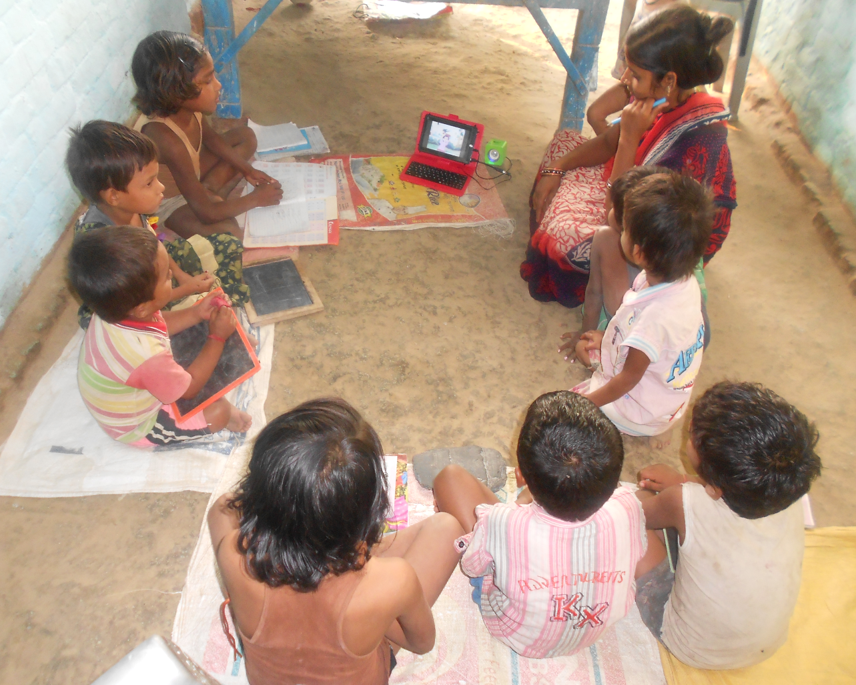
Objectives of the Initiative
Skill development of rural youth, as a community tutor in delivering quality learning
Improving learning levels of children through quality content delivery
Empowering within-village livelihood for youth by delivering quality educational & skilling services to fellow villagers.

Slide 8

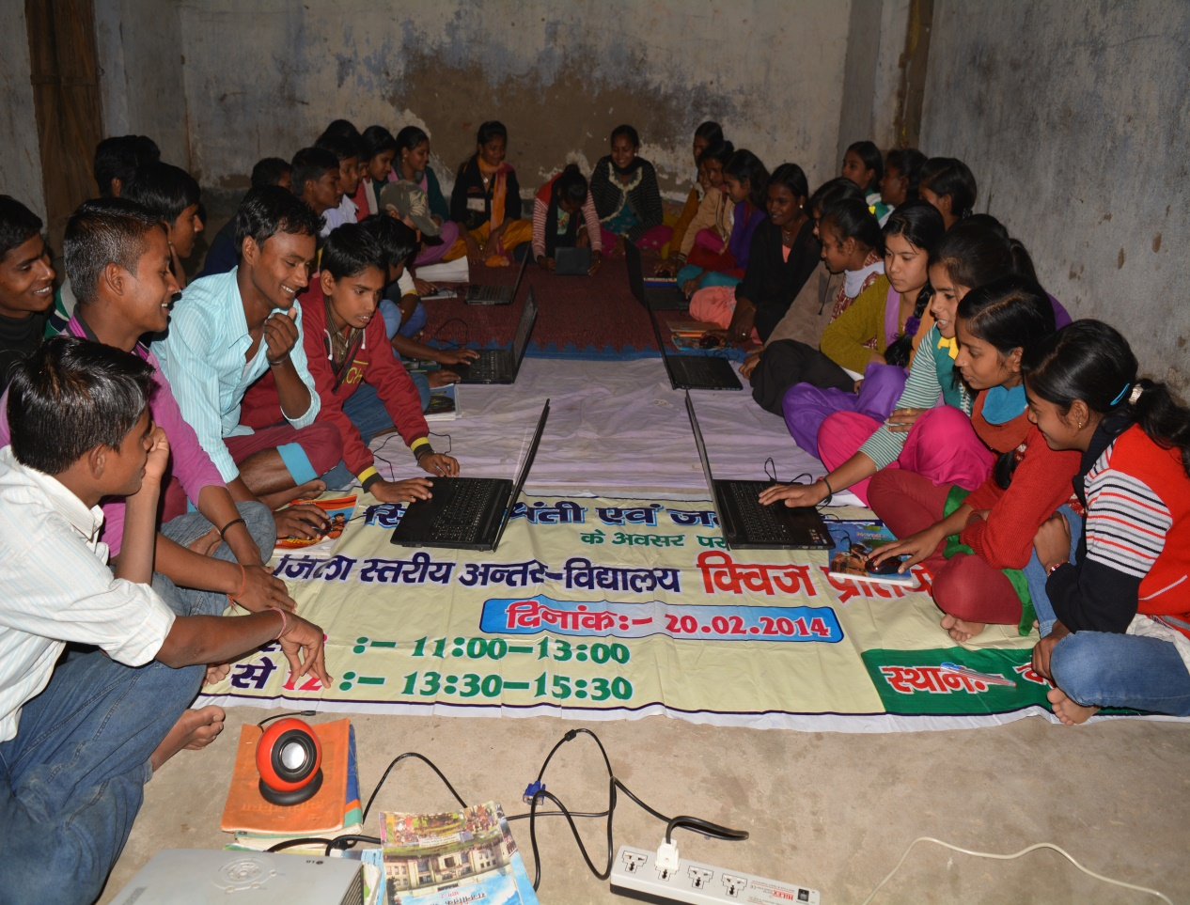
We wanted to improve the capability of individual through use of ICT tools by promoting digital literacy. We promoted the engagement of the youths with ICT tools to become an active stakeholder in development process through improved capabilities.
We shared a tablet with youth, trained them on pedagogy and the use of technology to deliver best practices at their
Saksham Kendras.

Slide 9
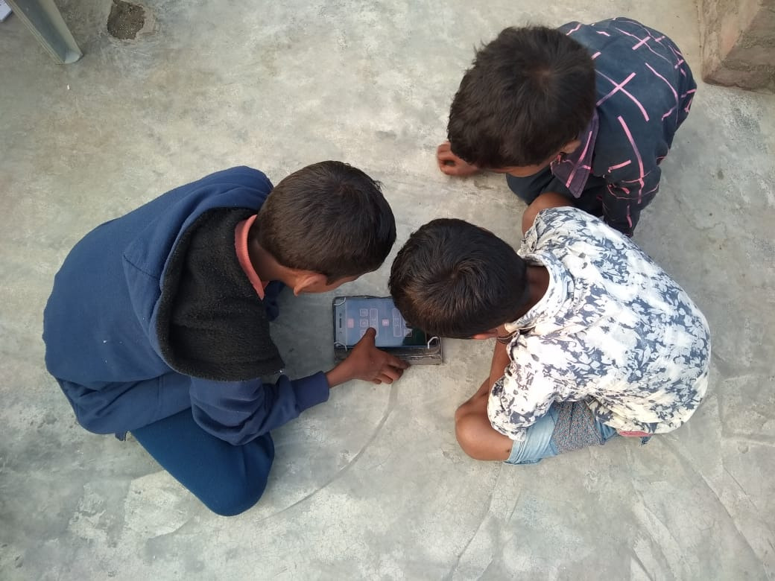
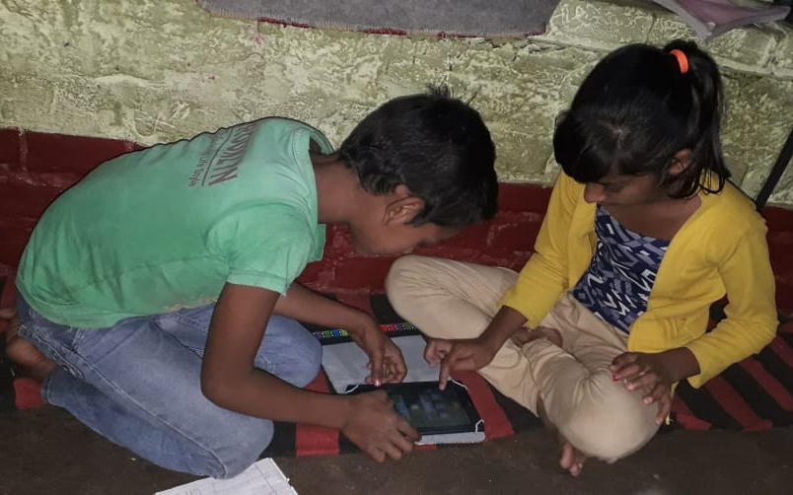
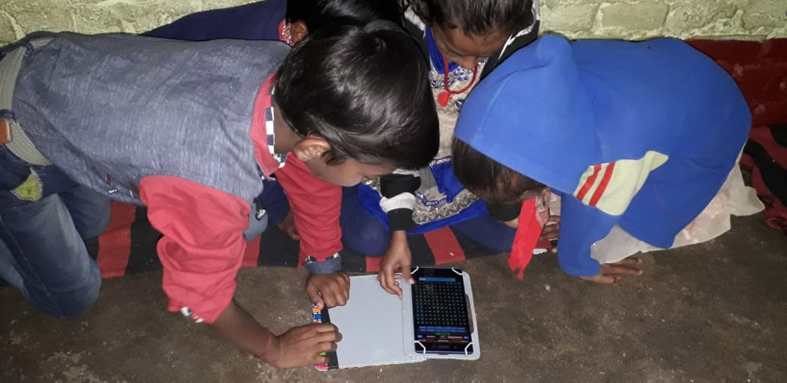
The Support and the Beginning
As of now 50 Android tablets have been crowd sourced through individual philanthropy and are placed with Residential Bridge Course schools, Remand Homes, Schools, Social Workers, Community Tutors and Students Self-Study Circles.
We work on low cost but good quality tablets. The total hardware cost along with content is around Rs.10000. It requires low investment and financial risk of failure is limited for the entrepreneur.

Slide 10
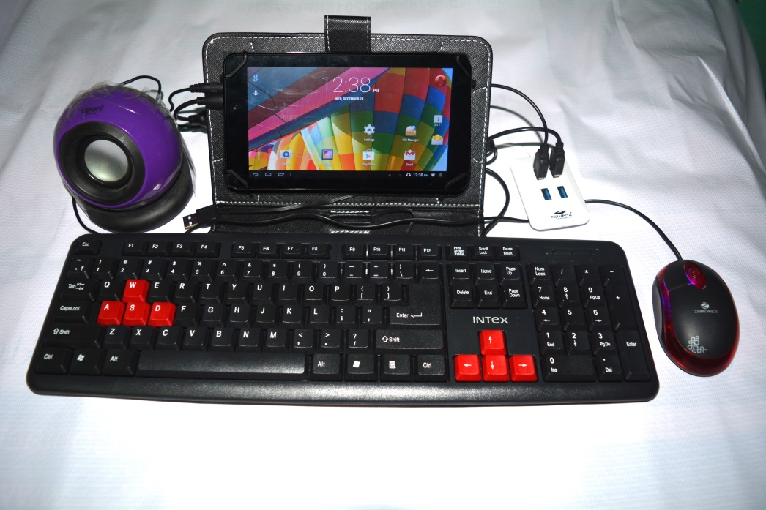
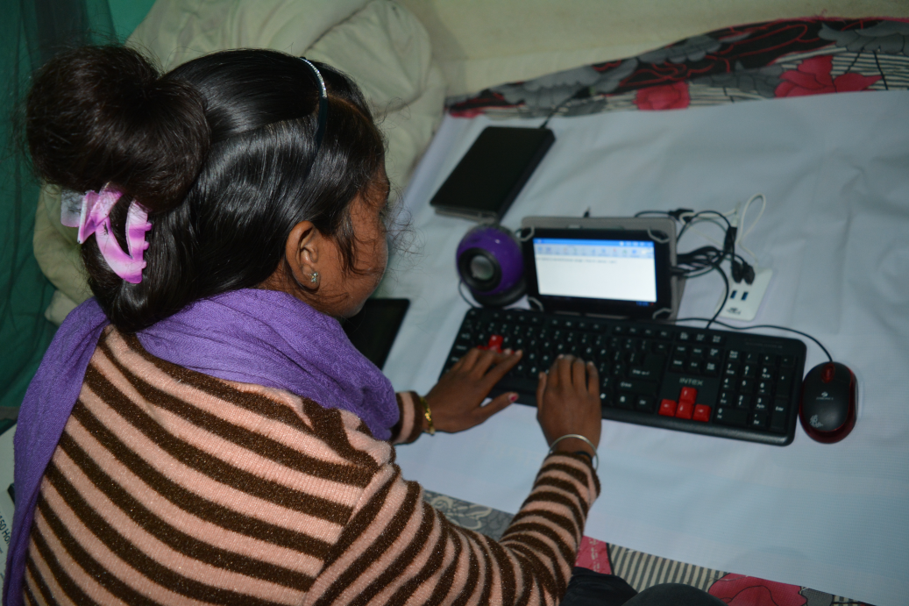
When Tablets were made the computers
The tablets were connected with a keyboard and a mouse, and this computer was then used to train community tutors.
And youths learned….
The youth was trained on the customized pedagogy to for effective learning among children at their Education Resource Centers. Tablets also helped youth attain digital skills.

Slide 11
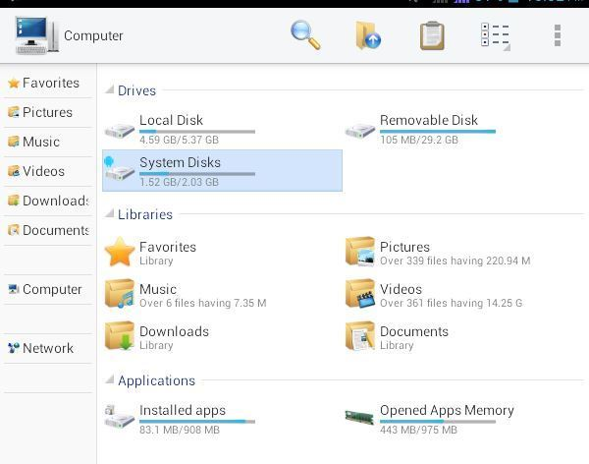
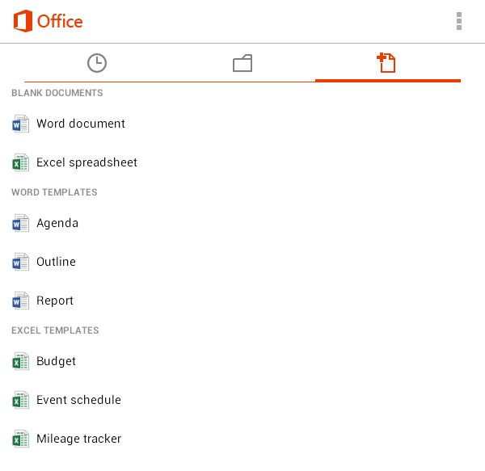

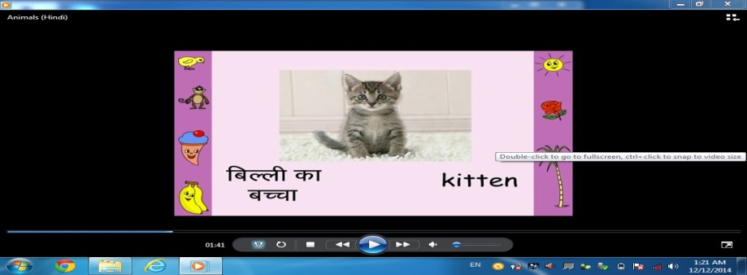
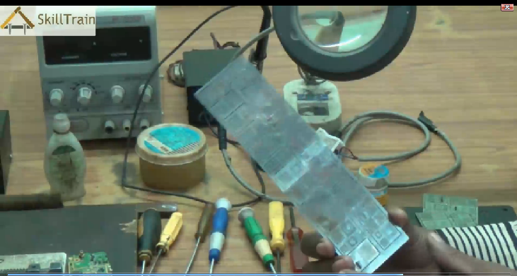
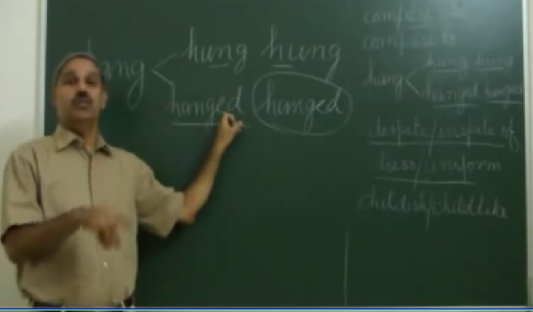
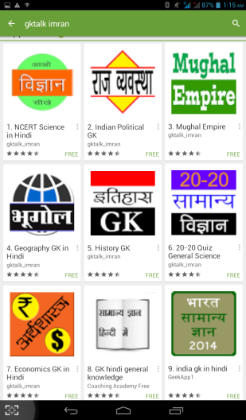
Content Loaded in Tablets
Digital literacy: Windows simulator on android (A. 20 students per centre)
Digital literacy; MS Office @ Android (A. 20 students per centre)
Class I-V digitised curriculum (B. 40 students)
Vocational training : Video lecture on Mobile repair, Computer & MS Office (A. 20)
Video lecture on Spoken English, Maths, GK etc. for Class VI-X (C.20 students)
Competitive Exam preparation (D. 20 students)

Slide 12
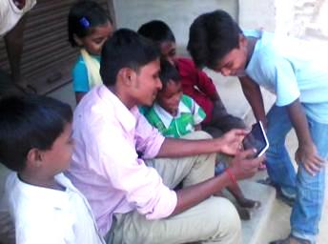
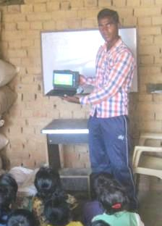
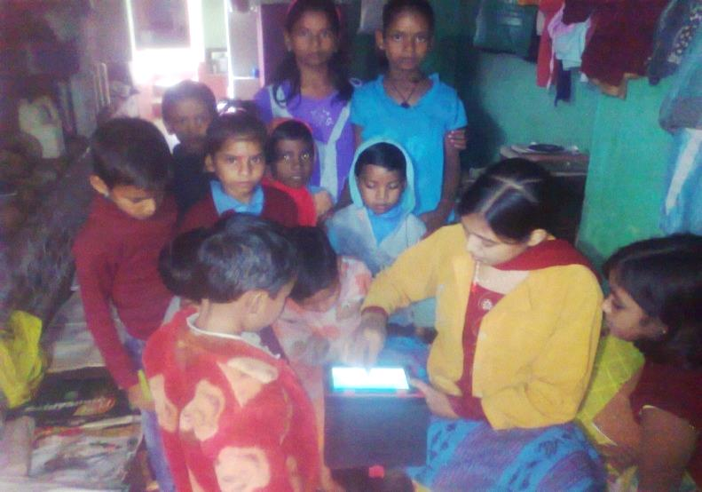
Children had an enriching experience and best quality education material became accessible to poor students at their door steps

Slide 13
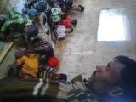
Stories from Field
Pradeep Manjhi, a 28 year old unemployed inter-educated youth from naxal affected village Koilu runs an i-Saksham Education Resource Centre (ERC). His ERC has 40 SC/ST children taking tuitions through android apps and digital videos daily at early morning before going to school. Pradeep’s experience with tablets has been phenomenal. He displays animated videos for first 20 minutes, and then gives practice tests using conventional methodology of pen-paper or chalk-slate. According to him, this pedagogy attracts kids and facilitates knowledge absorption. He finds interested in learning and building their skills as well.
Pradeep Manjhi,
Village Koilu
Children are more eager to attend tuition classes, says Pradeep.

Slide 14
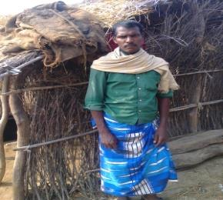
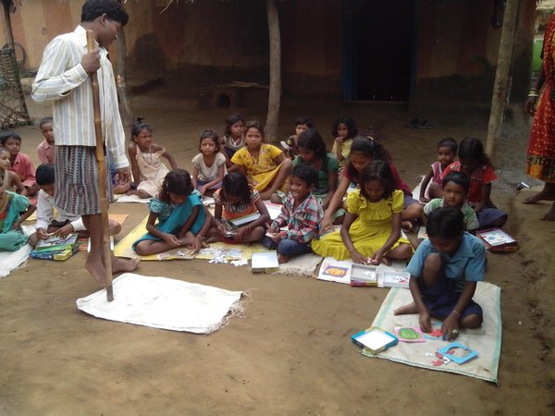
Jagadev Manjhi is sending his three children-Prabhat, aged 10 years in Std.5; Ranjani 8 years,in Std. 3; and Bhagirath, 6 years old in Std. 2 to ERC. He says “a notable improvement has happened in the learning level of my children. Now, my elder son can count numbers on his fingers and read poems
Quality Education At Doorsteps: Earning Within Village
Pintu is differently-abled 12th pass youth in extremism-affected village Sakhol, in Munger, Bihar. Due to financial challenges he could not study beyond class 12. Had very limited livelihood opportunities. In his pursuit, he saw opportunity in teaching children, observing the poor learning levels. As on date, with the support of i-Saksham, Pintu is imparting quality education to 45 children and is earning ~3000 Rs per month, within his village

Slide 15
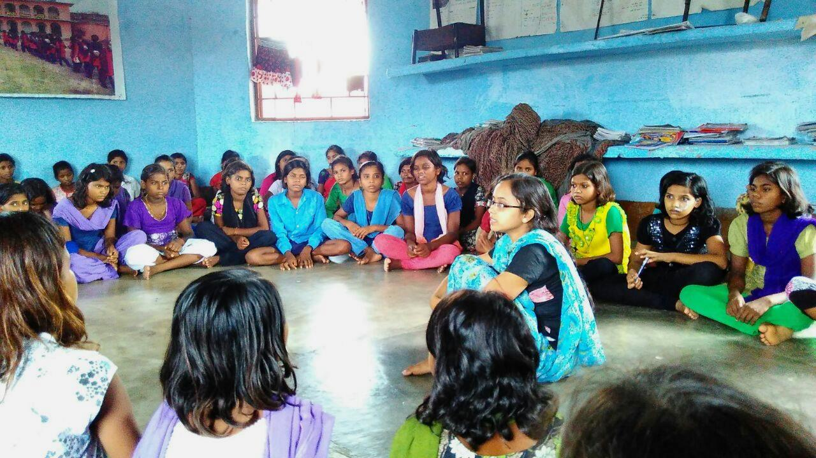
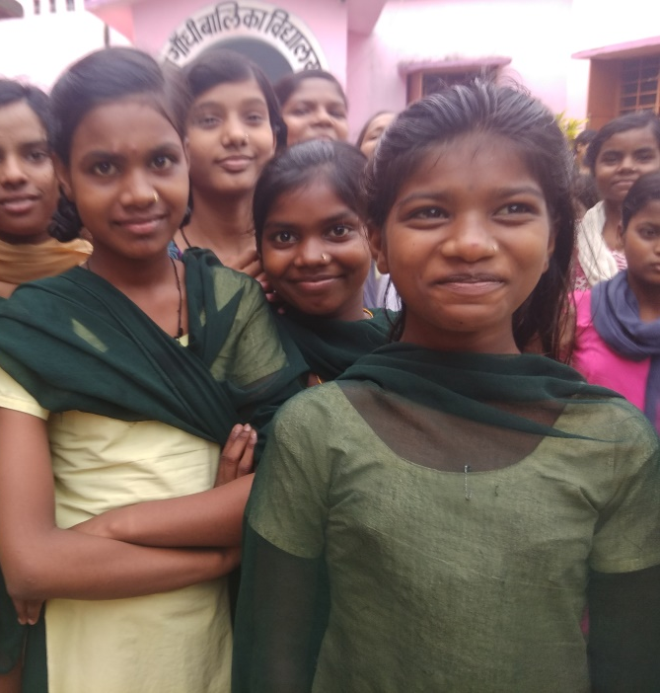
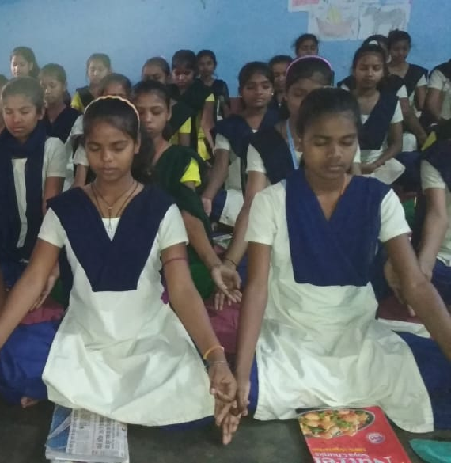
Our new Intervention at KGBV
We started our intervention at Kasturba Gandhi Balika Vidyalaya (KGBV), Jamui. At KGBV, we aim at promoting education on the principals of “learning by discovery,” ''learning through activity” and 'learning from the environment” in contrast to the prevailing textbook- centred 'learning by rote' method.

Slide 16
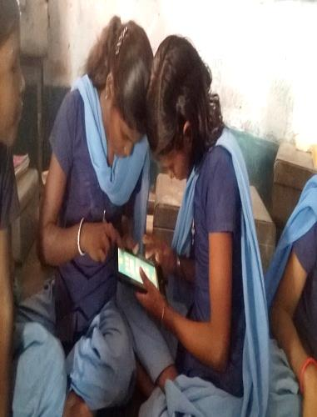
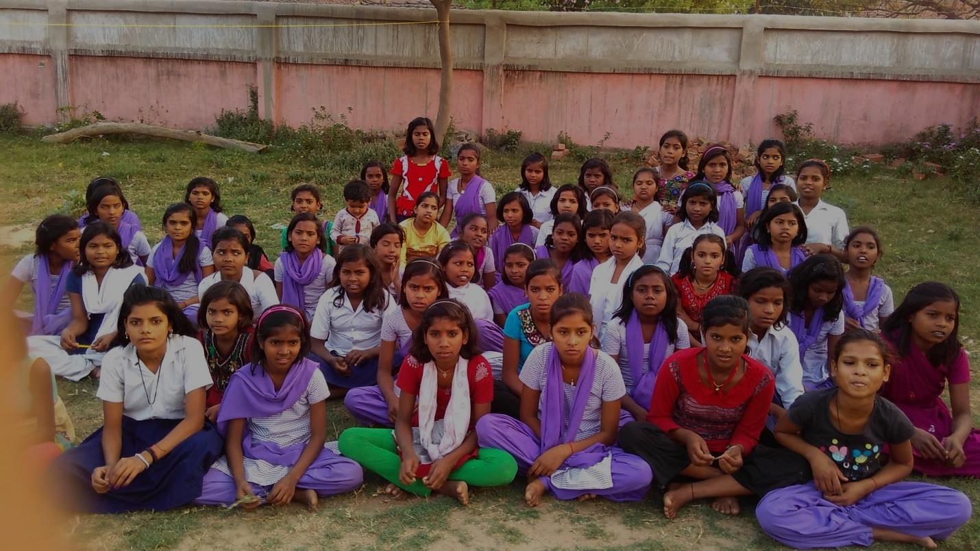
Features of the Intervention
Teacher training
2. Promoting activity based learning, not curriculum based rote one
3. Mainstreaming and bridging the gap between learning level and the grade level of a child
4. Weekly sessions with children by I-Saksham volunteers
5. Innovative ways of learning the basics of English, Mathematics
6. Engaging them with moral values and sanitation

Slide 17
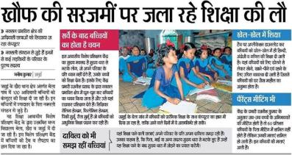
Awards and Acclamations
1.Residential Bridge Course Centers, Jamui
2. i-Saksham was presented as a model to develop tutorship as skill in difficult areas at workshop convened by MSDE
3. Covered in CSR today, local media, CNN-IBN
4. Top 50 proposals under Innovate for Digital India Challenge
5. Top 35 best practices selected under SAGY for replication across the county by MoRD.

Slide 18




Learning from the Year
After our pilot with 20 tutors we realized the need to prepare those youth and teacher’s training.
Though children spend time in schools but time consumed in learning is very low. For this, teacher’s should be trained on multi-grade and a multi-level classroom. There is also a need of resources and content that should be available to teachers.
Education and learning can’t completely be digital. Instead, digital content should be integrated with lesson plan, giving tech a complementary role.
There is a need to intervene in the traditional method that is being followed for teaching. Innovative practices in teaching are required and teacher-student relation should improve.

Slide 19
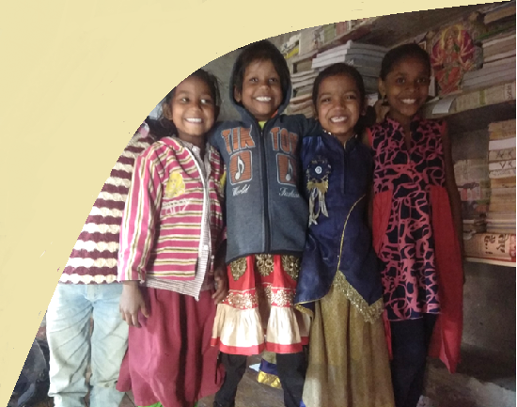
Plan 2016-17
  Train 300 new youth
  To establish i-Saksham as a reliable support to improve learning outcomes in children by brining visible change in the learning delivery of the community tutor
  Working out synergetic avenues to increase in-village earning opportunities for the community tutor (e.g. Digital Literacy)
We expect to reach up to 25,000 children in 2016

Slide 20
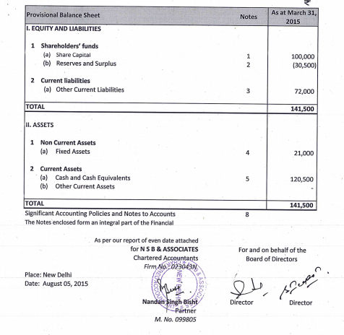
Financials

Slide 21
